Slide 1
Youth Placement
2nd and 4th Quarter After Exit
PIRL 1900/1901
Occupational Skills Training
Postsecondary Education
Secondary Education

Slide 2
Youth Employment and Training Measure
(Core Performance Measure)
A-1. Title I Youth Education and Employment Rate - 2nd Quarter After Exit
The percentage of Title I Youth program participants who are in education or training activities, or in unsubsidized employment, during the second quarter after exit from the program.
Credential Attainment: Remember, A participant who has attained a secondary school diploma or its recognized equivalent (HSE) is included in the percentage of participants who have attained a secondary school diploma or its recognized equivalent only if the participant also is employed or is enrolled in an education or training program leading to a recognized postsecondary credential within one year after exit from the program
P1900/1901: Is used as the Education segment of this core performance measure

Slide 3
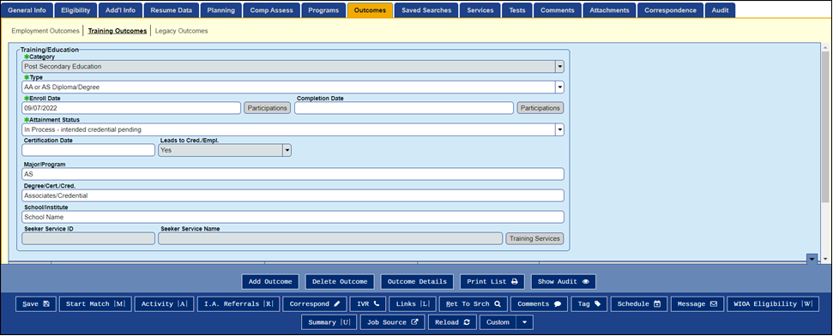
Capturing Youth Placement
Training Outcomes
Select Category: Secondary, Post Secondary, Occupational
Select Type: from dropdown
Attainment Status: In Process
Completion Date: Blank
Leads to Cred/Empl.: Yes or Blank
It can be tied to a previous training (i.e. HSE)

Slide 4
Capturing Youth Placement
Captured from the Training Outcomes Tab. The Outcome Tab is independent of other tabs; the outcome does not have to be associated with a Service or Achievement Objective.
Category: Secondary Ed., Post Secondary Ed. or Occupational Training
Type: Select from dropdown associated with the category
Completion Date: Blank
Attainment Status: In Process – Intended Credential Pending
Leads to Cred./Empl. – Yes or Blank

Slide 5
Documentation Requirements
• Cross-Match
• Copy of registration record
• Case notes (detailed)
• School records or verification of enrollment
• Transcript or report card
• Vendor/training provider training documentation

Slide 6
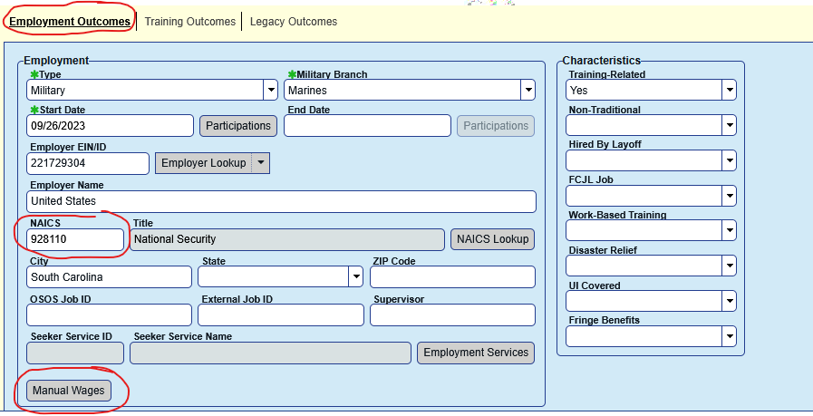
Capturing Military Employment
Military employment is captured from the Employment Outcomes Tab.
You MUST enter manual wages for it to be captured on the PIRL. A NAICS code MUST be entered to activate the Manual Wages Tab.

Slide 7
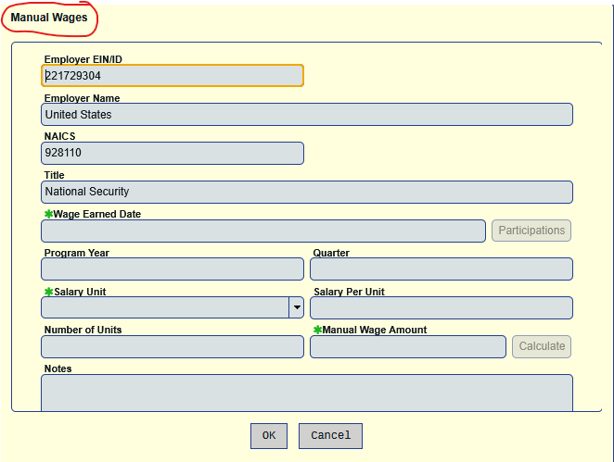

Slide 8
Post exit Training completion
If you are able to ascertain the participant completed their post exit training:
Fill in Completion Date
Change Attainment Status
Fill in Certification Date (required)

Slide 9
Data Entry errors
The following participant dropped out of the program, exited and could not be contacted. Even though Attainment Status was “Incomplete – did not attain or intend credential” because the completion date was left blank it filled in PIRL 1900 & 1901.
An analysis of a random sample of Youth credited with second quarter Youth Placement (PIRL 1900) revealed an error rate of roughly 25% because completion date was blank.

Slide 10
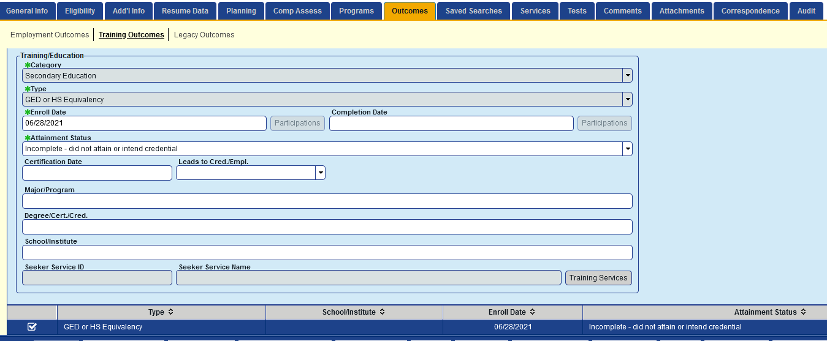
Data Entry errors
Completion Date Blank

Slide 11

questions

